Slide 1
Deep Computer Vision Using Convolutional Neural Networks

Slide 2
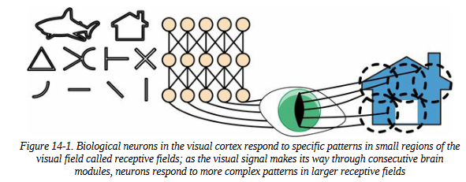

Slide 3
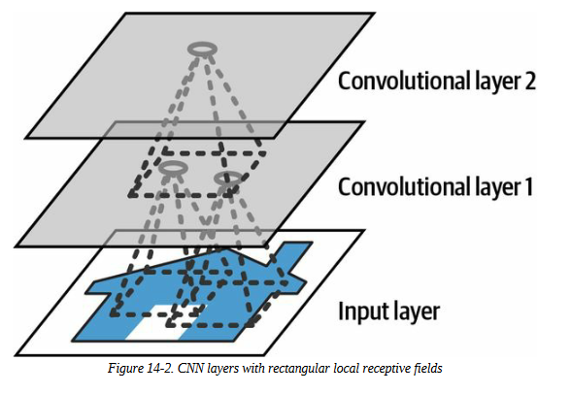
Convolutional Layers

Slide 4
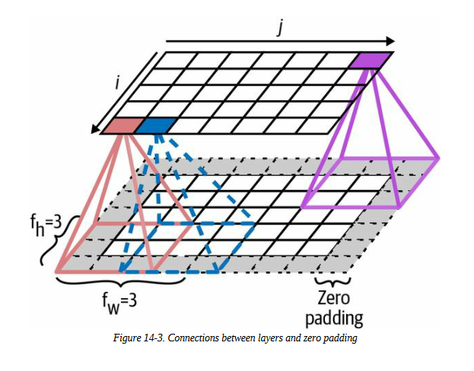

Slide 5
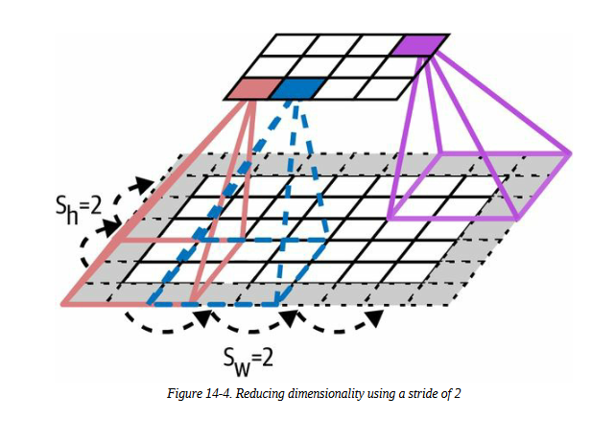

Slide 6
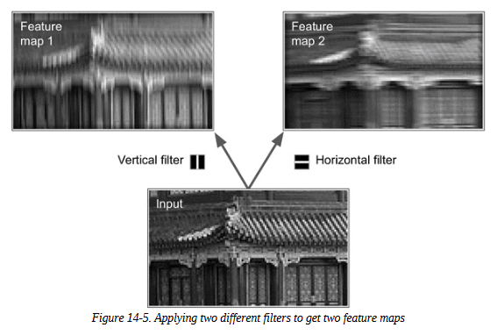
Filters

Slide 7
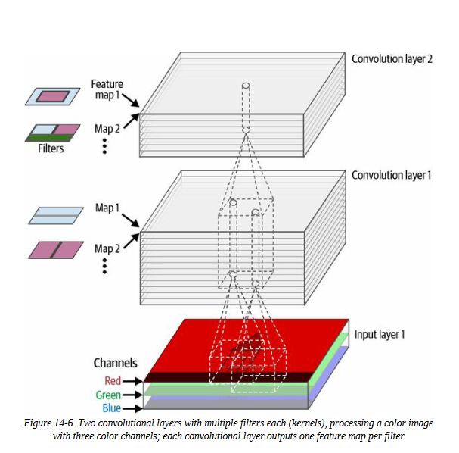
Stacking Multiple Feature Maps

Slide 8
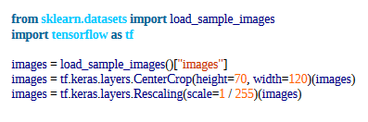



Implementing Convolutional Layers with Keras

Slide 9


set padding="same", then the inputs are padded with enough zeros on all sides to ensure that the output feature maps end up with the same size as the inputs

Slide 10
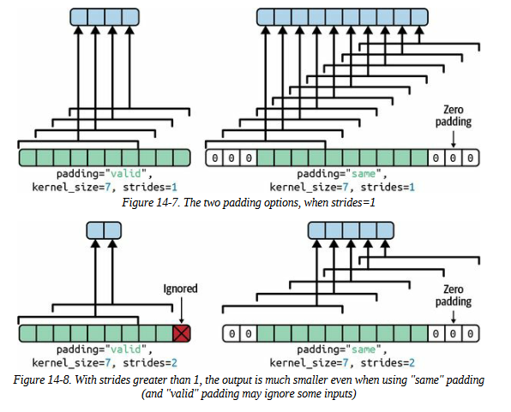

Slide 11
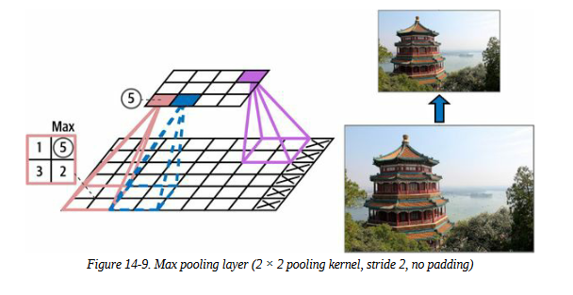
Pooling Layers

Slide 12
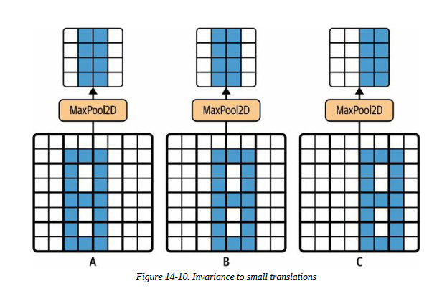
Other than reducing computations, memory usage, and the number of parameters, a max pooling layer also introduces some level of invariance to small translations

Slide 13
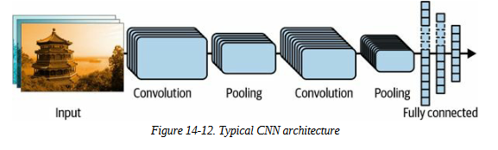
CNN Architectures

Slide 14

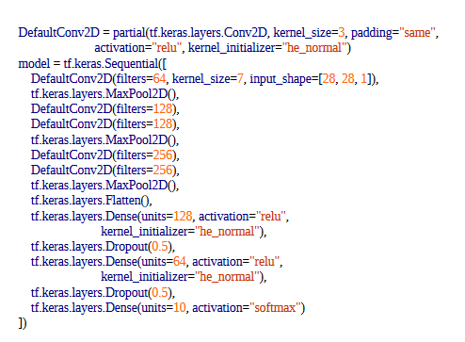

Slide 15
